Slide 1
My guessing game
By jack faulds

Slide 2
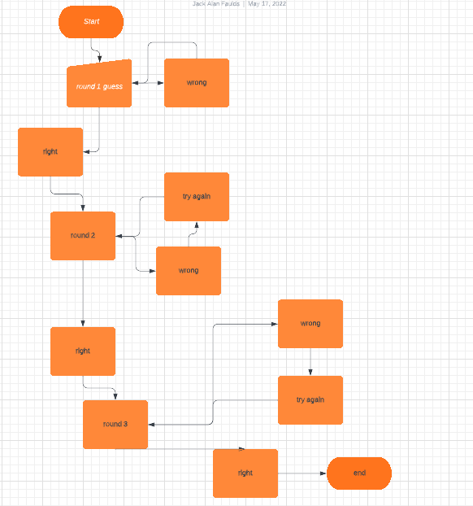
Flow chart
This is my flow chart and it indicates what happens in the code when things are imputed.

Slide 3
What I will be making
I will be making a quiz type guessing game where there will be a couple of rounds in the game that will be puzzles and you will have to do the puzzles to progress to the next round.
I do not want the questions to be that difficult and will maybe have some games in the mix aswell.

Slide 4
testing.
For the testing I will go through each stage of my code and test it as i go along so that it will all be working at the end.
I will be testing the code round by round so that everything works, I will also be testing previous rounds while trying to get to later rounds so I can probably find more errors with my code through the process.

Slide 5
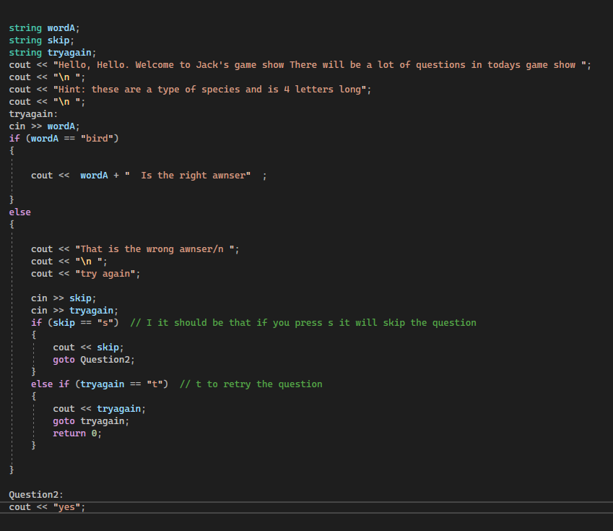
Question 1, Test 1.
This is the first question on the game and the code should be that if you get the answer right it will just go to the next question, but if you get it wrong you either press t to try again or s to skip. I have tested it and the only thing that does not work is when you get the answer wrong the second time. As it just automatically advances without knowing if it’s right or wrong.
It mostly works but in a weird way as in there needs to be an input after some of the couts and I don’t know how to fix it

Slide 6
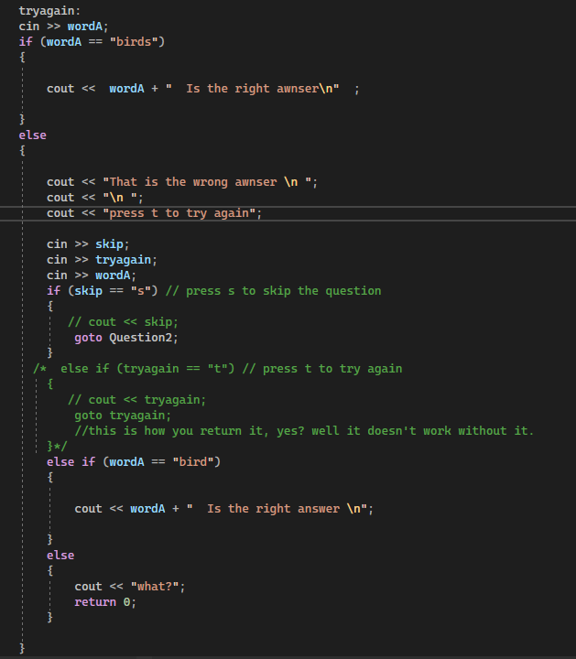
Question 1, Test 2.
So I took a long time to figure out why the input after the retry was not properly working, In the end I figured out that I did not need the else if try again and that was messing up the input. But after I got rid of that It started to work as intended.
The player has to enter T two times before retrying the answer. I did not know why this was happening so I could not fix the problem.

Slide 7
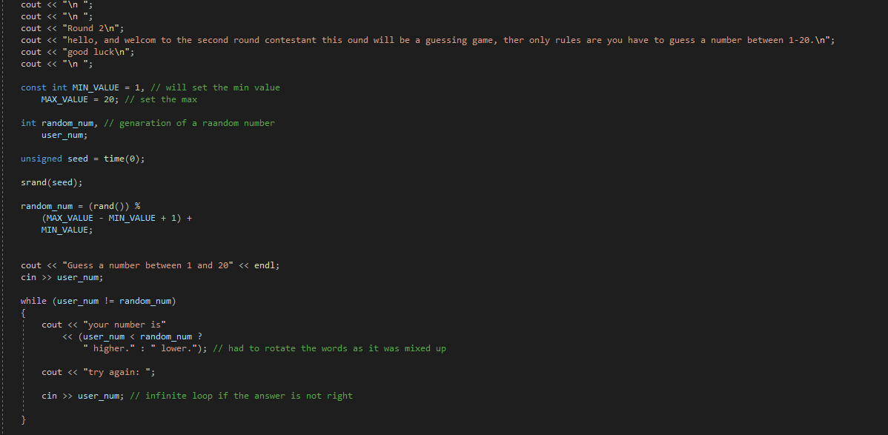
Question 2
For this code I looked at a tutorial to complete it. The process was quite easy and I did not go through many struggles while implementing the code in the game. I did change some things in the code so the player know what it means for example the higher and lower were mixed up in the tutorial and I thought 1-10 wasn't high enough for a challenge.

Slide 8
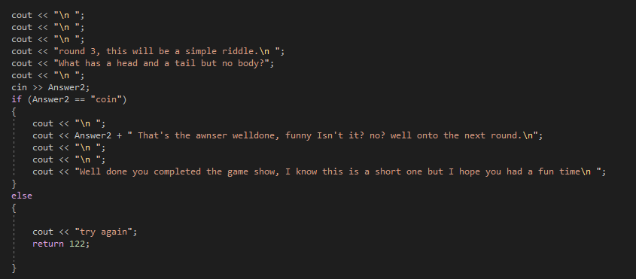
Question 3, test 1
For the finale round I went really basic with the code as there is only one if else statement and nothing really else. This code was not hard to implement so it took very limited testing.

Slide 9
Vlog link
https://youtu.be/ya5L4L-IRrY

Slide 10
references
“#20: Random Number Guessing Game - Chapter 5 - Tony Gaddis - Starting out with C++ - YouTube.” Www.youtube.com, www.youtube.com/watch?v=jIrKjOF3yMY&t=1s.

